Slide 1

B.Tech Project Evaluation, VIIIth Sem Project Title----Plant Leaf Disease Detection Using Deep Learning
Presented by :-
Name - Suhail Saifi,
SysID - 2018013282
Name - Bal Mukund, SysID - 2018014062
Name - Danish Alam, SysID - 2018007647
Under the Supervision of:-
( Dr. Ruqaiya Khanam)
Sharda University,
Gr. Noida
DEPARTMENT OF COMPUTER SCIENCE & ENGINEERING
SCHOOL OF ENGINEERING AND TECHNOLOGY
11th May, 2022
<number>

Slide 2
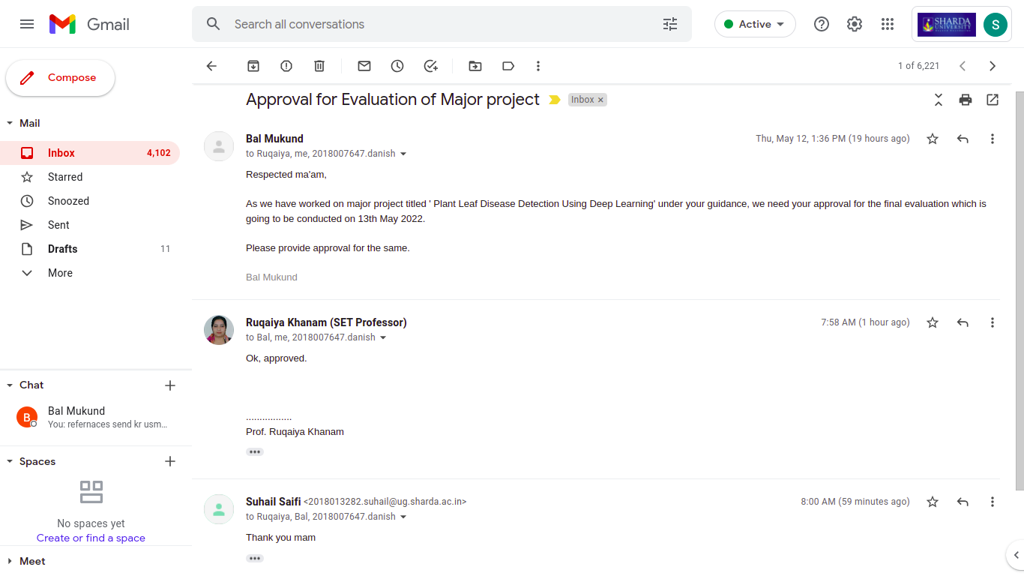
Approval from guide for the evaluation
Notes:
<number>

Slide 3
Contents of the Presentation:
Work load distribution and Project Planning
Introduction and Origin of the Research Problem
Motivation to research problem
Proof of paper accepted or communicated/ Hackathon/ Patent
Hardware and Software Used
Literature Survey
Dataset Used
Flow Chart
Web App
Results
Conclusion

Slide 4
Work load distribution and Project Planning
First of all, we decided the problem statement for our project as “Plant Disease Detection”.
Thereafter, we took help of the internet to find some knowledge about the topic, and searched for some relevant research papers on similar kind of projects.
After reading those papers, some summaries were written by us for each individual papers forming a literature survey.
After that a survey paper on this topic was written by us.
As a conclusion, we decided that Deep learning will be best approach for doing the project.
We proceeded with gaining vast knowledge about the topic and began coding for our project.
After completion of out project, we began writing a Research paper on this topic.
All the team member gathered information on the topic, read many papers
written on this topic and after that we as team did the project and wrote papers.

Slide 5
Introduction and Origin of the Research Problem
Plant diseases are documented to scale back the food available to humans by ultimately interfering with crop yields. This can result in inadequate food for humans or lead to starvation and death in the worst cases. Agriculture plays an important role within the Indian economy. Around 70 precent of rural households are dependent on agriculture. Agriculture is one among the important sector of the Indian economy because it contributes about 17% to the entire GDP and provides employment to over 60% of the population. Direct economic impact of a trans boundary pest or disease is that the loss or reduced efficiency of agricultural production – whether it’s of crops or animals - which reduces farm income. So, the detection of disease through some automatic technique is useful because it reduces an outsized work of monitoring in big farms of crops, and at a really early stage itself it detects the symptoms of diseases that appear on plant leaves. This paper includes different sections. The first section gives a brief introduction about the importance of plant disease detection. The second section discusses the existing work carried out recently in this area and also reviews the techniques used.

Slide 6
This 'Plant Leaf Disease Detection Using Deep Learning' project is a software algorithm that can effectively detect leaf disease on an image input. This project reflects the potential of image processing techniques with the help of a deep learning algorithm to get a clear and defined image or to extract some useful insight from it. Also, CNN is used for image classification. CNNs are equipped with input, output, and hidden layers which help in process and in image classification. The primary goal of this project is to create the "Leaf Disease Detection" expert system, which employs a Deep Learning approach to define any type of leaf disease.
As we wanted to formulate a real-time Plant Disease Detection System, to infer between the efficacy of pre-trained models over Multi-Class Dataset we collated Plant Leaf Dataset from Kaggle which is open to use. The Dataset consists of 15 Classes with a diverse variety of Plant Leaves. TensorFlow and Keras have been induced for working upon Deep Learning Architectures. OpenCv is used for reading and processing images. Numpy for saving the images in array format. Sklearn for one hot encoding,training and testing split, calculating the performance of the model. Matplotlib and Seaborn for plotting graphs in a much more advanced way. Gradio, an open-source python library for creating web-apps has also been utilized for creating a web app for Plant Disease Detection.
Notes:
<number>

Slide 7
Motivation to research problem
To find the interactions between the diseases causing agents and host plant in relation to overall environment.
To identify various diseases in plants.
To implement a method for preventing the disease and providing management for reducing the losses/damages caused by diseases.
Prevent diseases on plants for Farmers.
Help out the pesticide company in predicting the new pesticide solutions.

Slide 8
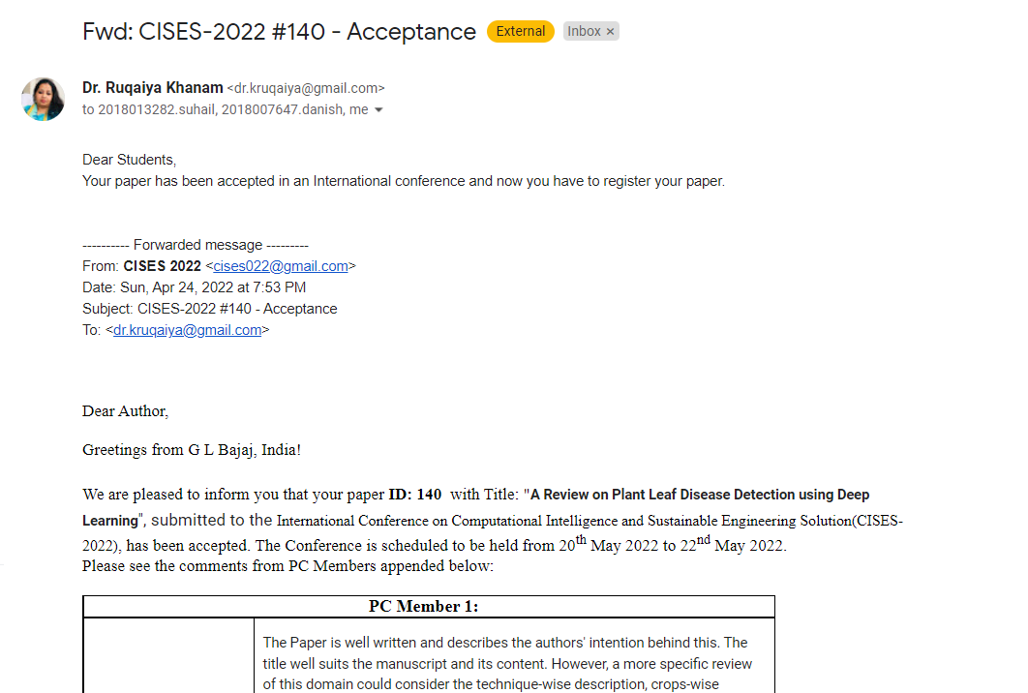
Proof of paper accepted or communicated/ Hackathon/ Patent

Slide 9
Hardware and Software Used
Operating System: Windows 7 and above
Language and Technology used: Python, Deep Learning, HTML, JavaScript
Browser used: Google chrome
Hardware: Quad core Intel i5 or higher, 8GB of RAM.\
Disk Space : The amount of disc space available depends on the partition size and whether or not online help files are allowed. The MathWorks installer would tell you how much disc volume your partition needs.
Graphics Adapter : 8-bit graphics adapter and display (for 256 simultaneous colors)

Slide 10
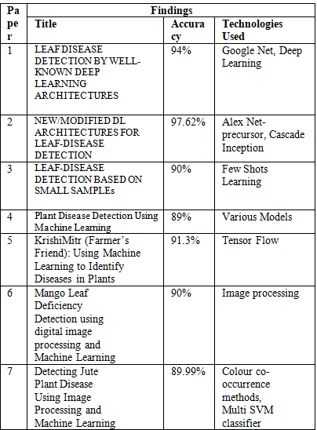
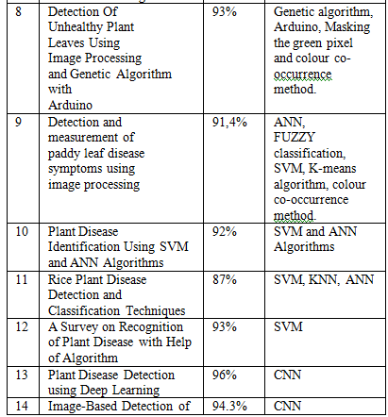
LITERATURE SURVEY

Slide 11
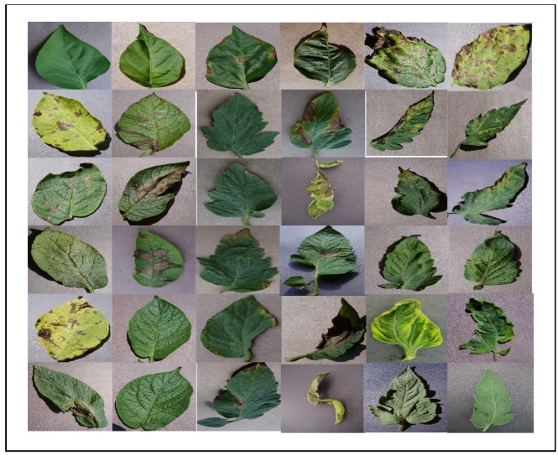
Dataset Used
As we wanted to formulate a real-time Plant Disease Detection System, to infer between the efficacy of pre-trained models over Multi-Class Dataset we collated Plant Leaf Dataset from Kaggle which is open to use. The Dataset consists of 15 Classes with a diverse variety of Plant Leaves elucidated in Figure. There are 20935 instances of Data for scrutinizing the model’s performance. The illustration of the Dataset is shown in Figure.

Slide 12
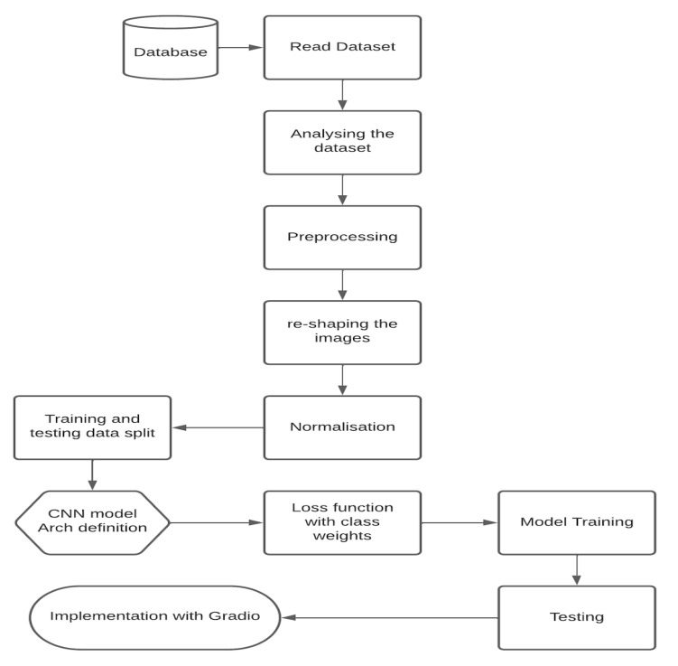
Flow Chart

Slide 13
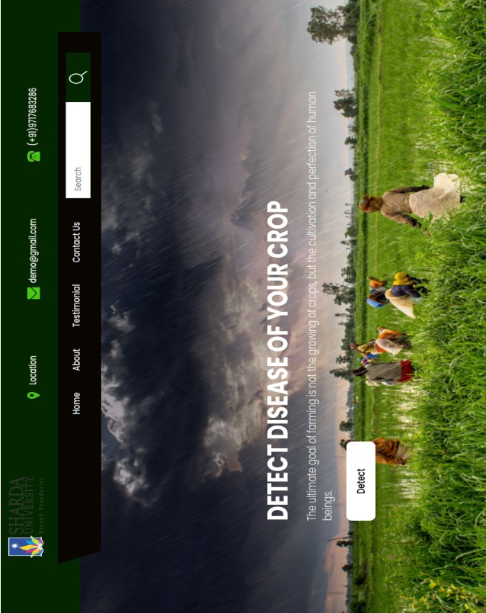
WEB APP

Slide 14
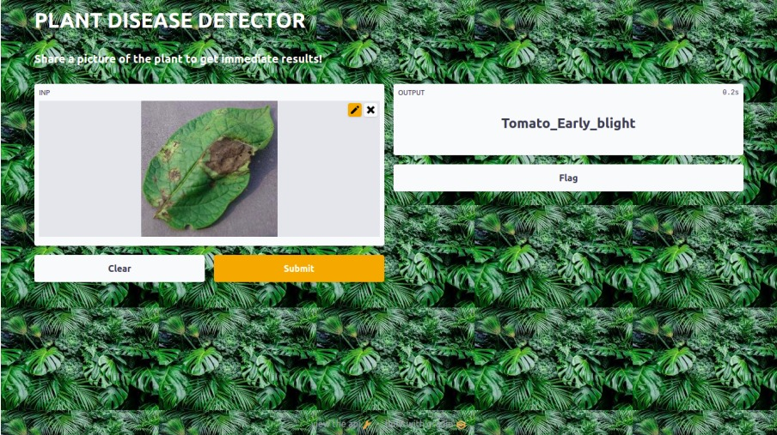

Slide 15
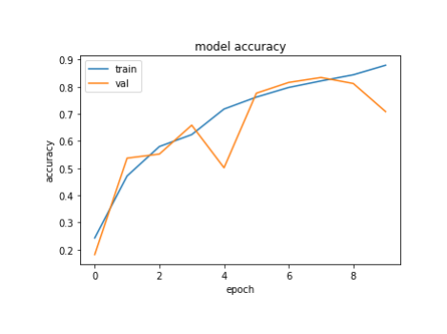
RESULTS
After the Implementation of the proposed outlook, we got phenomenal results for the model that we have selected for building the Plant Disease Detection System which was VGG16 and a worthy insight was procured through it. Below figures represent the graphical perspective of the model in terms of Accuracy and Loss.
As we have used VGG architecture for training the model and from that we achieved 97% of accuracy, and made the calculation of precision, recall, F1-score for each class.

Slide 16
CONCLUSION
Plant disease detection has become a very big domain to work on, because many of the works have been done earlier using many different technologies and methods in this field. We so far have read some of these papers for our survey and have analyzed and have found many different results for different techniques and methods used. The papers were on same topic but of different methodologies like few of them were based on image processing, few were of deep learning, FSL, ML etc. We have analyzed that even after doing so much research in this domain, there is a large scope of research in future also because every proposed model has some constraints, some disadvantages and some advantages. The need for perfect model to detect the plant leaf disease is also in hunt and this is the reason that these models are not getting used on large scale for disease detection. This a very good and very helpful domain to work on because when farming is done on a very big scale, it is not possible for farmers to look for diseases on every leaf of the plants, so further research and findings on this domain can be very helpful.

Slide 17
So after comparing the results of different models, VGG16 architecture is the best modus operandi as it works better with small data and large data also and after our research we got the accuracy of 99% in some of the present classes, like the category Tomato_Target_spot is the least accuracy scored which is 82% the category Pepper_bell_healthy, Potota_b, etc are the highest accuracy scored which is more than 99%
As a result, it’s necessary to scrutinize over varied architectures for finalizing the base model for any modus operandi. The efficacy we got stands out as the best in assuaging this system and more dataset can be amalgamated for greater explication as an outlook.

Slide 18
GitHub Link:
https://github.com/Suhailsaifi780/Plant-Disease-Detection-Using-Deep-Learning-Web-App.git

Slide 19
THANK YOU

